Slide 1


Talking at home: Extremism

Slide 2






Talking at home
Here are some ideas on how to have conversations at home.
When to talk: try to find a time when there are fewer distractions around.
Where to talk: it’s best to talk in a relaxed, quiet and neutral place if possible.
How to talk: listen carefully, explain simply, ask questions and be patient.
Getting started…
Use these buttons below to move through the slides.
Find this button in the bottom right of you screen to start the slides.
Use the arrow keys to go forwards and backwards through the slides.
To go back to your normal screen, press the esc key on your keyboard.
–
Videos & References:
Please use the notes section for alternative video links and references on each slide.
Don’t forget to vote…
At the end of this lesson, vote on the question as a family. Do you all agree?
Notes:
Images:
https://icons8.com/

Slide 3

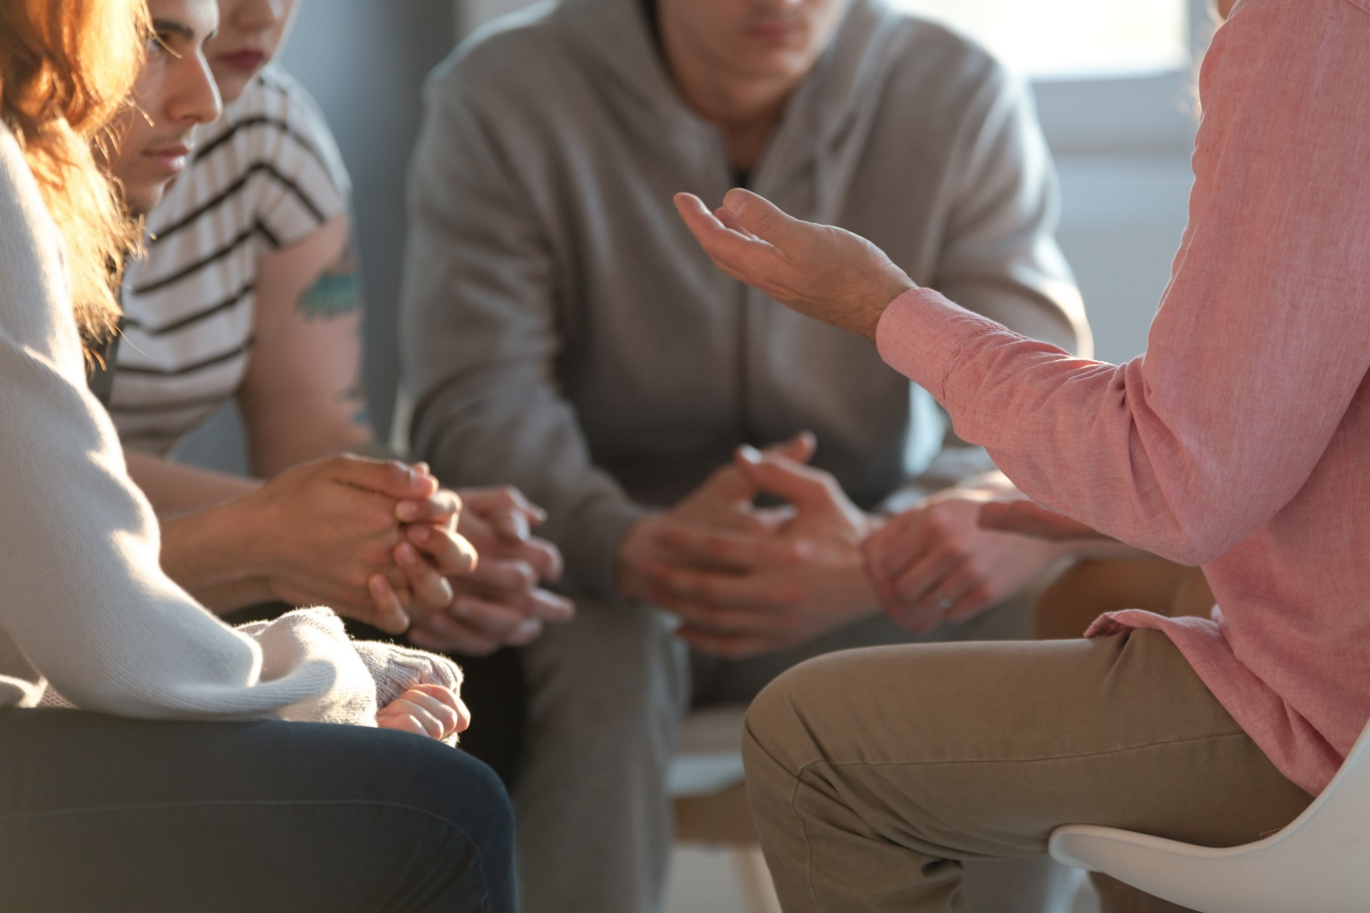

Can sharing stories prevent extremism?
This resource aims to encourage a conversation across the whole family about how sharing personal stories and experiences can help us learn about extremism and understand how to avoid being drawn into extreme ideas. We are thinking particularly about the impact of COVID-19 on this.
If you are concerned by any of the issues raised in this ‘talking at home’ session, click on the Let’s Talk About It website logo to find out about how they can
help you as a parent or carer. Also, see the final slide for some more advice
on who to talk to.
Notes:
References
https://www.ltai.info/
Images:
iStock

Slide 4






1
What is an extreme view?
Show your vote (3-5 mins)
On the next slide, discuss the five different views as a family. Where would you put them on the scale, from least to most extreme? Show your answer with your fingers. Can you explain why you think this? Do you all agree?
Extreme¹:
A view that might seem unreasonable or unacceptable, often because it is hateful towards someone else.
Not extreme
Very extreme
Notes:
Images:
iStock
https://emojipedia.org/apple/
References:
1) https://dictionary.cambridge.org/dictionary/english/extreme

Slide 5
1
What is an extreme view?
Extreme¹:
A view that might seem unreasonable or unacceptable, often because it is hateful towards someone else.
Everyone should be able to live wherever they want.
People who eat meat should be punished.
Girls shouldn’t play football. They ruin the game.
People who commit a crime should be in prison forever.
We should all have the same religion.
Not extreme
Very extreme
Notes:
Images:
iStock
https://emojipedia.org/apple/
References:
1) https://dictionary.cambridge.org/dictionary/english/extreme

Slide 6

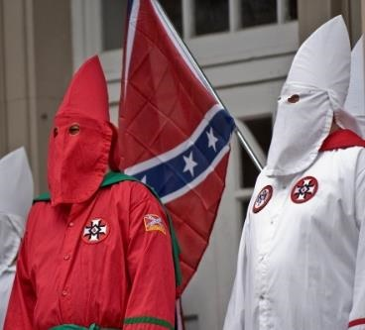
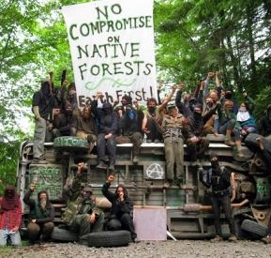
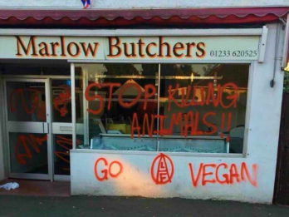
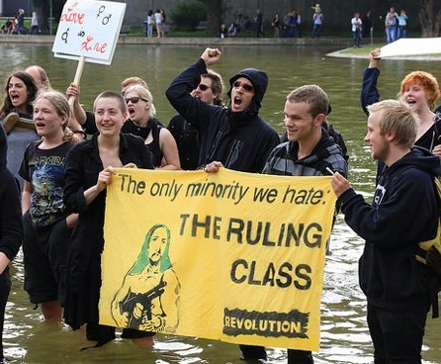
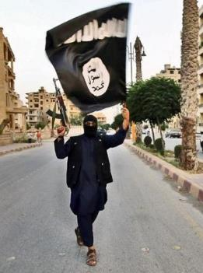
1
What is an extreme view?
Discuss (1 min)
What do you think an extremist is?
An extremist strongly supports a certain idea or cause in a way that most people find unreasonable. They may use these views to justify hateful or harmful behaviour towards those they oppose or who oppose them.
Religion
Different extremists groups could target anything. They may dislike certain people because of their opinions, lifestyle, identity or culture.
Politics
Race
They will look out for vulnerable people who they can persuade to agree with their extremist views.
Gender
Notes:
Images:
https://foreignpolicy.com/2017/09/01/the-green-radicals-are-coming-environmental-extremism/
https://www.ft.com/content/bde61e42-9243-11e7-a9e6-11d2f0ebb7f0
https://www.breitbart.com/europe/2018/05/28/vegan-activists-threaten-fire-bomb-butchers-animal-rights-attacks-rise/
https://www.flickr.com/photos/arete13/4126186099
https://www.haikudeck.com/title-uncategorized-presentation-tRjFKPce3j
https://www.exberliner.com/features/opinion/could-you-be-a-left-wing-extremist/
iStock
References:
https://educateagainsthate.com/school-leaders/define-extremism-terrorism-uk-2/
https://www.ltai.info/

Slide 7
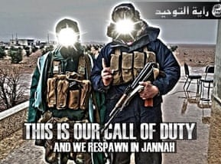


2
Extremist propaganda
Propaganda:
Information or images designed to influence a person’s opinion.
Ask your child (2-3 mins)
Have a look at some of this extremist propaganda. What strategies are they using to promote their cause? Hint: how are they trying to make the reader feel?
Making their cause seem brave or exciting
One strategy is creating stories to prove their cause is justified and heroic.
They may also create narratives which present “different” groups as the enemy.
Promising solutions or a better life
Creating a feeling of belonging and identity
Blaming certain groups for problems
Notes:
Images:
https://www.adl.org/education/resources/tools-and-strategies/table-talk/propaganda-extremism-online-recruitment
https://edition.cnn.com/2019/08/19/opinions/portland-protest-antifa-proud-boys-opinion-obeidallah/index.html
https://www.theguardian.com/world/2014/jun/23/who-behind-isis-propaganda-operation-Iraq
https://commons.wikimedia.org/wiki/File:%22Freedom_go_to_hell%22.jpg
https://southdakotapolitics.blogs.com/south_dakota_politics/2009/04/obama-no-good-very-bad-day-in-london.html

Slide 8


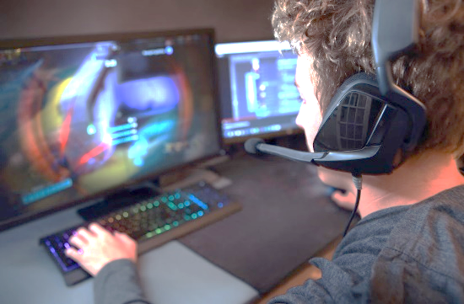
3
Why should we talk about this?
Discuss (1 min)
How has COVID-19 changed your communication and the way you spend your time? (Adults too!)
Coronavirus is having a significant impact on young people and families across the world, changing the way that we live, learn and communicate with others.
With schools closed too, we’re all using the internet more than ever to play, learn and talk to our friends.
Work it out: How much time are you spending online each day?
While it doesn’t happen that often, unfortunately there are people online who use the internet, social media and gaming to spread extreme ideas.
Notes:
References
https://www.ltai.info/
Images
https://www.standard.co.uk/news/london/westminster-survivor-describes-being-thrown-like-a-rag-doll-over-khalid-masoods-car-a3517336.html
https://www.pinterest.co.uk/pin/104075441370483785/?lp=true
https://www.standard.co.uk/news/london/families-of-westminster-attack-victims-demand-end-to-online-extremism-a3740341.html
https://i2-prod.mirror.co.uk/incoming/article12638965.ece/ALTERNATES/s615b/EMB-Incident-at-London-Bridge.jpg
https://metro.co.uk/2019/09/20/hollyoaks-deserves-praise-gets-tackling-far-right-extremism-uk-10778280/

Slide 9
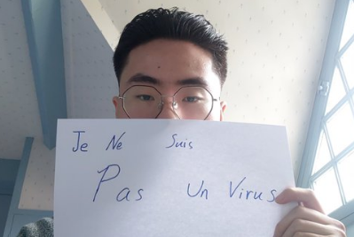
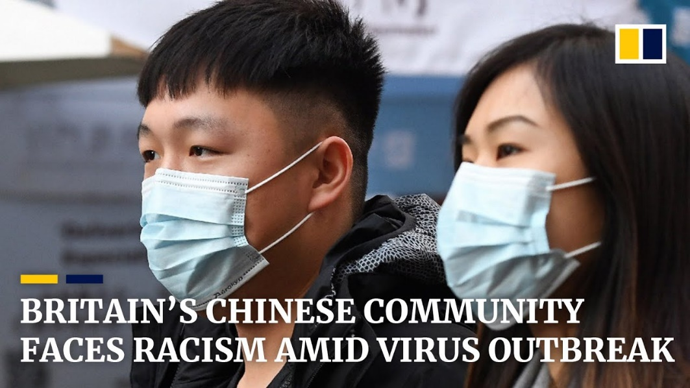
3
Why should we talk about this?
Misinformation and fake news can also play a part in spreading extreme ideas.
For example, in some places, misinformation and fear surrounding Coronavirus has led to East-Asian people being mistreated, including abuse and violent attacks.
Translation: “I am not a virus”
0:00-1:33
Watch (2-3 mins)
Click the image to watch a short video. How is this affecting different communities in the UK?
https://safeshare.tv/x/ss5ea028716221b
Notes:
Alternative video link: https://www.youtube.com/watch?v=gQILO63LobA
Images:
https://www.youtube.com/watch?v=gQILO63LobA
https://www.scmp.com/comment/opinion/article/3050542/coronavirus-triggers-ugly-rash-racism-old-ideas-yellow-peril-and
References:
https://youtu.be/2Z1pOEjajaY

Slide 10

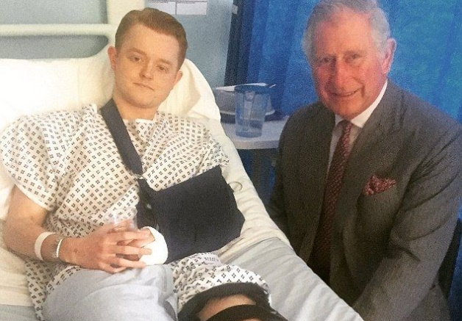
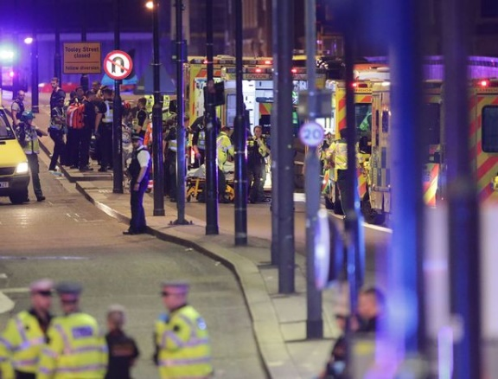

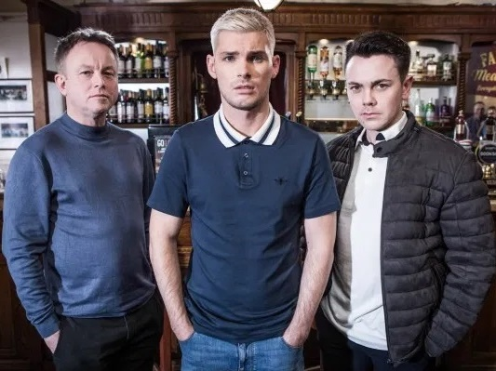
4
Real-life consequences
During COVID-19, there will be people who want to influence children and young people and take advantage of the time they are spending online.
Talking about this as a family will help everyone in your house to understand the dangers that are out there.
The people you are going to hear from have shared their stories to help raise awareness and improve our understanding of the real effects extremism can have.
However, it is important to remember that extreme groups also use stories to persuade people to become part of their organisation.
Notes:
References
https://www.ltai.info/
Images
https://www.standard.co.uk/news/london/westminster-survivor-describes-being-thrown-like-a-rag-doll-over-khalid-masoods-car-a3517336.html
https://www.pinterest.co.uk/pin/104075441370483785/?lp=true
https://www.standard.co.uk/news/london/families-of-westminster-attack-victims-demand-end-to-online-extremism-a3740341.html
https://i2-prod.mirror.co.uk/incoming/article12638965.ece/ALTERNATES/s615b/EMB-Incident-at-London-Bridge.jpg
https://metro.co.uk/2019/09/20/hollyoaks-deserves-praise-gets-tackling-far-right-extremism-uk-10778280/

Slide 11


4
Real-life consequences
On 3 June 2017, a van was deliberately driven into pedestrians on London Bridge. The attackers crashed the van, then ran to the nearby Borough Market area and began attacking people. The attackers were inspired by Islamic State (ISIS).
“The people who did this are just human beings like you and me.”
0:00 -1:31
Thomas* witnessed a family member being hit by the car on London Bridge.
Video task (3-4 mins)
Watch and discuss your thoughts on Thomas’ story. What message is he trying to give about the attackers? Do you agree?
“No one is born a terrorist.”
Challenge:
How could a situation like Thomas’ push someone towards extremist views?
https://safeshare.tv/x/ss5dc5435358d3a
Notes:
*Name changed to protect the privacy of the speaker.
Alternative video link: https://www.youtube.com/watch?v=a9I56Yr__MI
Alternative link:
References:
1) https://en.wikipedia.org/wiki/2017_London_Bridge_attack
Images:
https://www.pinterest.co.uk/pin/104075441370483785/?lp=true
https://i2-prod.mirror.co.uk/incoming/article12638965.ece/ALTERNATES/s615b/EMB-Incident-at-London-Bridge.jpg

Slide 12
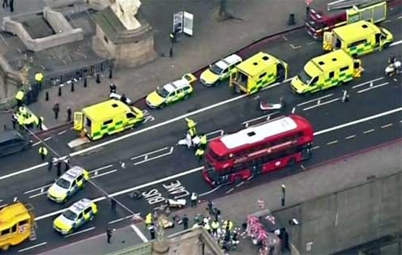
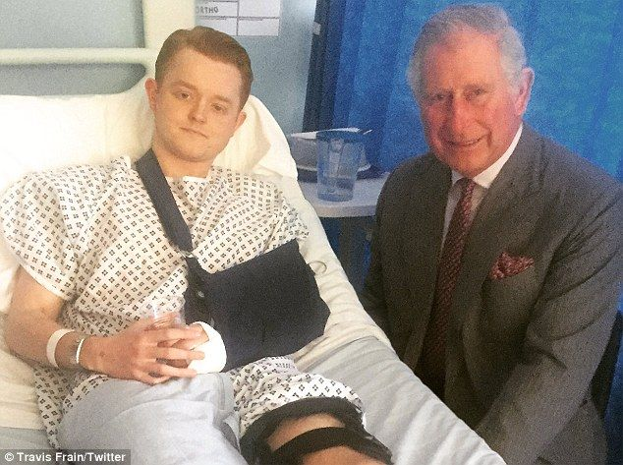
4
Real-life consequences
On 22nd March 2017, a terrorist attack took place on Westminster Bridge. The attacker drove a car onto the pavement and injured more than 50 people. Five people died.
0:00 -1:22
Video task (3-4 mins)
Watch the video or read the summary below and discuss:
What would you do if you thought one of your friends was being drawn into extremism? Would you know what to look out for?
Travis was one of the people injured that day.
It took Travis 18 months to recover from his injuries. He wondered whether this tragedy could have been prevented if the terrorist’s family and friends had spotted the signs.
Challenge:
How might extremists use this story to help their cause?
https://safeshare.tv/x/CQsnabyOwyc
Notes:
Alternative link: https://www.youtube.com/watch?v=CQsnabyOwyc
Images:
iStock
https://www.pinterest.co.uk/pin/104075441370483785/?lp=true

Slide 13






5
The other side of the story
Family chat (4-6 mins)
What are these statements trying to make you feel?
Extremist groups also tell stories which are personalised to make the listeners feel certain emotions. The stories may be based on true events, exaggerated or completely made up.
“It’s time to get revenge for what they’ve done.”
“Life will be better without them.”
“We need people like you.”
“No one is listening, we have to take action.”
“We have to defend ourselves.”
“They are to blame.”
“We know how you feel.”
Angry
Afraid
Victimised
Proud
Hopeful
Valued
Notes:
Images:
https://emojipedia.org/apple/

Slide 14

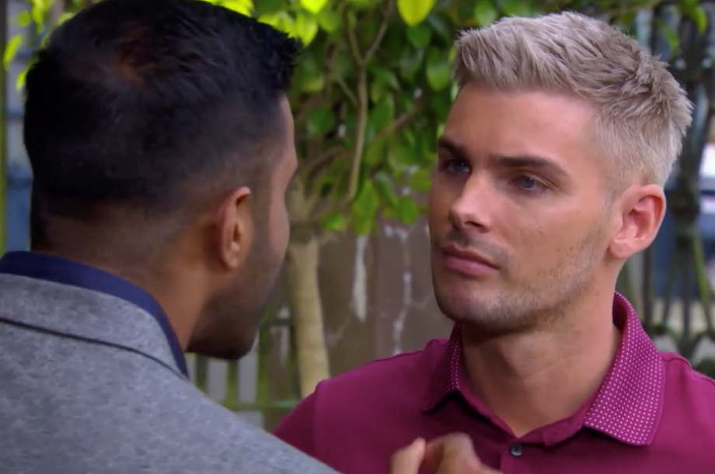
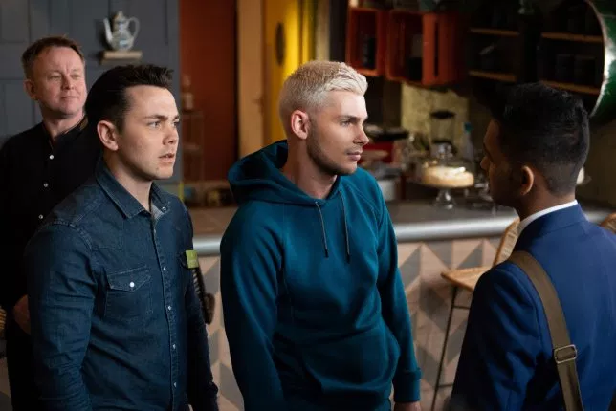
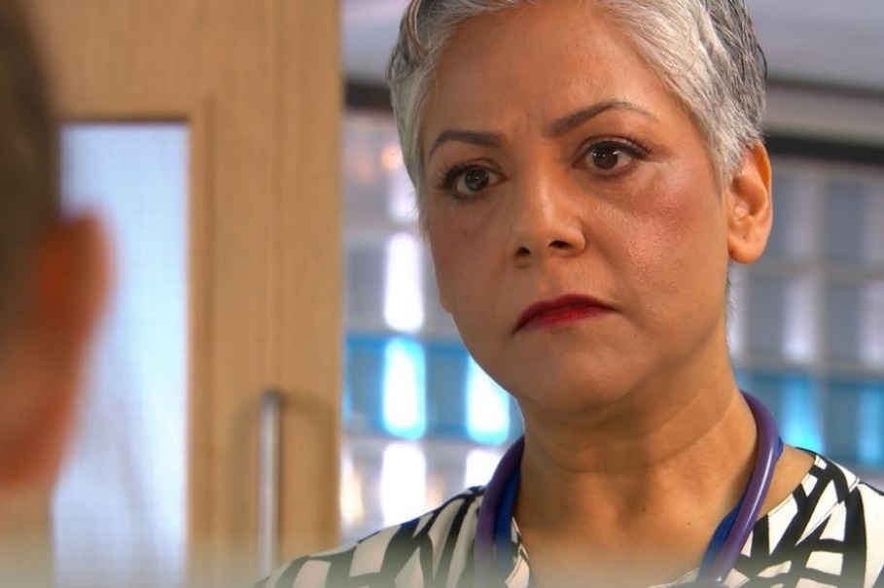
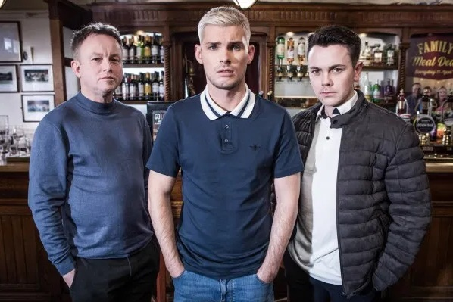
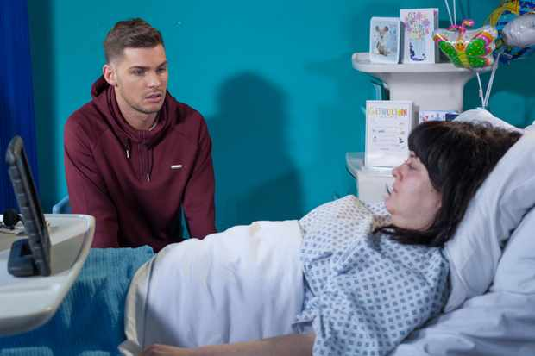
5
The other side of the story
Hollyoaks drew attention to extremism through Ste’s storyline in 2019…
Ste’s sister died in a terrible accident, which left him upset and angry.
He blamed the doctor, Misbah, for her death because thought she had made a mistake when caring for his sister.
Members of an extreme group, Jonny and Stuart, recognised that Ste was vulnerable and gained his trust.
They told Ste that people like Misbah should be blamed for most of his problems because they are Muslim. They tried to persuade him to damage a local centre that many Muslims use.
Hollyoaks wanted to portray how extremism and radicalisation can happen to anyone and show what you can do if you’re worried that yourself or someone you know is being radicalised.
After some encouragement from his family, Ste agreed to talk to a Prevent officer who helped him break his ties with the extremist group.
Radicalise:
Making someone become more extreme in their beliefs.
Notes:
References:
https://www.digitalspy.com/soaps/hollyoaks/a29726264/hollyoaks-spoilers-ste-hay-escape-mercedes-suspects/
https://dictionary.cambridge.org/dictionary/english/radicalize?q=radicalise
Images:
https://www.radiotimes.com/news/2018-03-27/hollyoaks-tegan-is-awake-will-she-tell-ste-the-truth-about-ryan/
https://www.mirror.co.uk/tv/tv-news/hollyoaks-shock-misbah-maalik-decides-11827951
https://metro.co.uk/2019/06/13/hollyoaks-spoilers-ste-hay-discovers-the-shocking-truth-about-racist-jonny-baxter-9949481/
https://metro.co.uk/2019/05/02/hollyoaks-spoilers-ste-makes-a-shocking-decision-after-leela-tackles-racist-jonny-9394596/
https://www.facebook.com/permalink.php?id=351853981687338&story_fbid=1023822891157107

Slide 15

5
The other side of the story
0:00 -3:39
To make the storyline similar to real life, Hollyoaks also worked with John.
John used to be part of a far-right extremist group. He told his story to Hollyoaks and the writers used the information to make the programme.
Video task (5-6 mins)
Listen to John’s story. What lies did the extremist group tell him? Who helped him to leave the group?
Far-right groups are often based on hate, believing that certain groups of people shouldn’t live with others.
There are some racist groups that encourage hate and violence that are banned in the UK.
Extension:
Why do the Hollyoaks cast think it’s important to tell this story?
https://safeshare.tv/x/ss5dcc3a6c45a53
Notes:
Alternative video link https://www.youtube.com/watch?v=h3dhvmPEqwE (0:00-4:05)
*Name changed to protect the privacy of the speaker.
Alternative link:
References
Definition paraphrased from EDL Mission Summary
Jackson, Paul (2011). The EDL: Britain's 'New Far Right' Social Movement (Report). Northampton: University of Northampton
Busher, Joel (2018). "Why Even Misleading Identity Claims Matter: The Evolution of the English Defence League". Political Studies. 66 (2). pp. 323–338
Images
https://www.manchester.ac.uk/discover/news/book-provides-rare-glimpse-inside-the-english-defence-league/

Slide 16



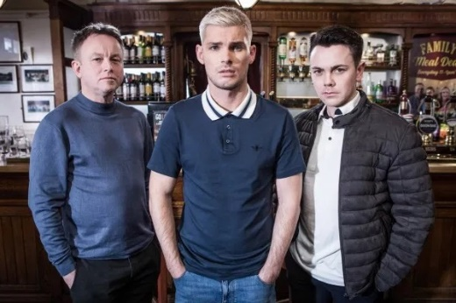
6
Why share these stories?
“This is my story, but there’s another side to this.”
““They’re just very angry people who are using the far right as a way to vent their anger.”
Family chat (3-5 mins)
Why do you think these people have decided to share their stories with you? What are they trying to achieve or avoid?
Challenge:
How might extremists use these stories to help their cause?
“No one is born a terrorist.”
Notes:
Images
https://www.pinterest.co.uk/pin/104075441370483785/?lp=true
https://www.manchester.ac.uk/discover/news/book-provides-rare-glimpse-inside-the-english-defence-league/
https://time.com/3281925/somalia-al-shabab/
https://i2-prod.mirror.co.uk/incoming/article12638965.ece/ALTERNATES/s615b/EMB-Incident-at-London-Bridge.jpg

Slide 17

6
Why share these stories?
0:00 -5:35
Video task (7-10 mins)
Watch the rest of the video on John, Hollyoaks and Prevent. How can talking to organisations like Prevent help people in John or Ste’s position? How can talking to family help?
https://safeshare.tv/x/ss5dcc3cf735f43
Notes:
Alternative video link https://www.youtube.com/watch?v=h3dhvmPEqwE (4:07-end)
Images
Hollyoaks

Slide 18

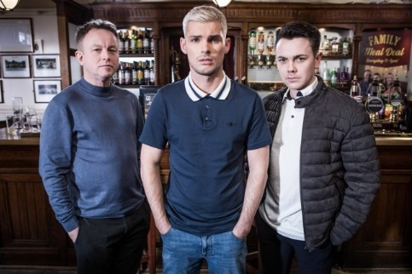
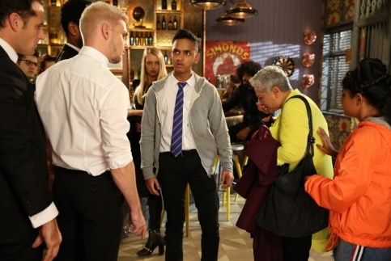
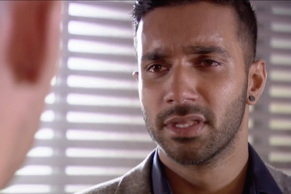
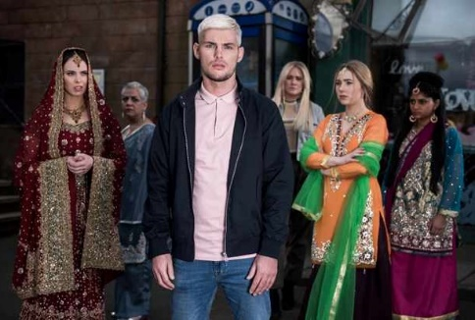
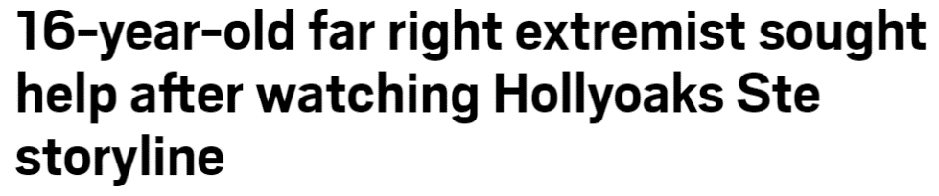
6
Why share these stories?
Hollyoaks has been praised for teaching audiences how to spot the signs of extremism, both in person and online.
“These groups use social media to target vulnerable and lost people - and then try to [change] the way they see the world.”
Harvey Virdi, actress
The show has also encouraged people to speak about their experience. This headline was published in 2019:
Family chat (2-3 mins)
Can showing extremism on TV help prevent it from happening in real life?
Notes:
Images:
1) https://metro.co.uk/2019/09/18/16-year-old-far-right-extremist-sought-help-watching-hollyoaks-ste-storyline-10767829/
2) https://thunderbirds.fandom.com/wiki/Harvey_Virdi
3) https://www.radiotimes.com/news/2019-06-06/hollyoaks-spoilers-ste-radicalisation-far-right-storyline-maalik-family/
4) https://metro.co.uk/2019/06/13/hollyoaks-spoilers-ste-hay-discovers-the-shocking-truth-about-racist-jonny-baxter-9949481/
5) https://www.radiotimes.com/news/2018-11-20/ste-attacks-misbah-over-tegan-death-as-hollyoaks-feud-turns-sinister/
References:
1) https://metro.co.uk/2019/09/18/16-year-old-far-right-extremist-sought-help-watching-hollyoaks-ste-storyline-10767829/
2) https://www.femalefirst.co.uk/tv/news/rishi-nair-hollyoaks-far-right-plot-hard-watch-1210754.html

Slide 19

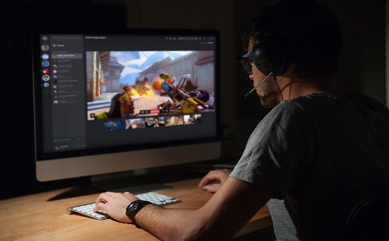

7
What should families look out for?
The internet makes it easier for children and young people to engage with new groups or individuals and this can make them vulnerable to those who are looking to influence them.
Online radicalisation can be hard for parents to pick up on as it is complex. However, there are some possible signs to keep an eye on:
Exploring new and unusual websites or forums
Changes in identity and language
Joining new or secret groups, talking to new people
Sharing religious, political or hate based videos online
Radicalisers can target children and young people by messaging on popular apps and websites. They then wait to see who responds before then taking the conversations further on a private platform.
https://safeshare.tv/x/ss5dcc3cf735f43
Notes:
Images
iStock
References
Ltai.info

Slide 20








What can you do…
8
These are indicators that they might need help, but you know your child best and we advise that you speak with them first. Check in with them and ask them about what they are viewing, who they are speaking to and how they are feeling. This might feel difficult, but here are some tips to help you:
Listen carefully to their fears and worries. There are some helpful tips here.
Avoid complicated and worrying explanations that could be frightening and confusing.
There is advice and support to help them understand Coronavirus
If they are finding it hard to cope with bereavement and grief - advice can be found here.
You can get more information from the following websites, these will help you understand why people sometimes need
more support if they have been radicalised, what is available and how to access it.
Notes:
Images & references
https://www.nspcc.org.uk/
https://www.internetmatters.org/
https://parentinfo.org/
https://www.npcc.police.uk/CounterTerrorism/HomePage.aspx
https://www.childline.org.uk/
https://www.thinkuknow.co.uk/
https://www.ltai.info/

Slide 21


Can sharing stories prevent extremism?
YES
NO
We can learn from other people’s experiences and keep ourselves safe.
Stories are more memorable than statistics or information, which helps us remember the message.
Stories have always been used to teach us lessons. They help us learn.
Many people our age are more likely to watch shows like Hollyoaks then listen to the news, so these stories can make more of a difference.
People can lie in stories and teach us the wrong thing.
Extremist groups also use stories to manipulate people into joining them.
While stories might help promote understanding and reduce extreme views, actions bring about change, not talking.
Stories can only get us so far; we need people like the police to keep us safe.

Slide 22


You can vote from home at… https://www.surveymonkey.co.uk/r/SSVGLQV
To have your voice heard!
If you have any issues, feedback or comments, email aisling@votesforschools.com
Notes:
Alternative video link: https://youtu.be/FoQ45XPO_WQ

Slide 23

Need more information or someone to talk to?
Students | Parents/Carers | Other useful links
Remember, you can always talk to a trusted adult, like a teacher or a family member, if you are at all worried about anything. | If you need to talk to someone about the concerns you have for a child, call the NSPCC helpline on 0808 800 5000. They are open 24/7. | To report any online material you think promotes extremism or terrorism, go to: https://www.report-terrorist-material.homeoffice.gov.uk/report
Visit the ‘Let’s Talk About It’ website, a guide which gives practical help and guidance on what to do if you think someone might be being radicalised. https://www.ltai.info/ | NSPCC gives advice for adults worried about a child becoming radicalised. | NSPCC launched a free 24 hour helpline on 0808 800 5000 for anyone worried about radicalisation and the impact of terrorism. They have access to trained counsellors.
If you need to talk to someone and you’re not sure who to go to, call Childline, a confidential helpline for children, on 0800 1111 – they are open 24/7 (all the time!) www.childline.org.uk | DfE website Educate Against Hate gives teachers, parents and school leaders practical advice and information on protecting children from extremism and radicalisation. https://educateagainsthate.com/ | To report suspicious activity to the police, you can either call them in confidence on 0800 789 321, or complete this online secure reporting form at: https://act.campaign.gov.uk/ If it’s an emergency call 999.
 | Family Lives offer advice for professionals and parents if they are worried about a child being radicalised. | Families Against Stress and Trauma (FAST), provide support to vulnerable families and individuals whose lives have been affected by the trauma of losing loved ones to hateful ideologies and groups.

Slide 24
Find out more at
Votesforschools.com

